Slide 1

R-FCN: Object Detection via Region-based Fully Convolutional Networks https://arxiv.org/abs/1605.06409
Authors:
Jifeng Dai - Microsoft Research
Yi Li - Tsinghua University
Kaiming He - Microsoft Research
Jian Sun - Microsoft Research
Presenter:
Gurkan Kilicaslan - University of Minnesota

Slide 2
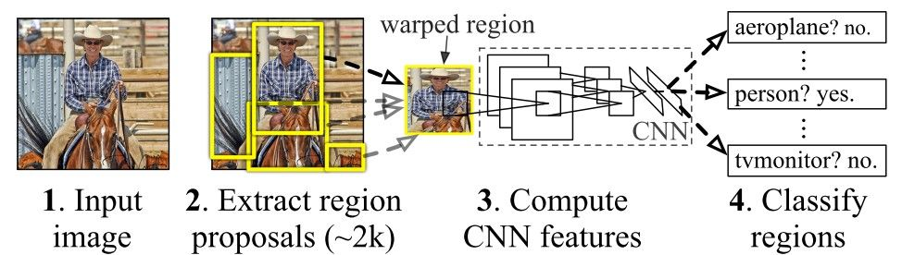
Problem and Motivation
Object detection is a fundamental challenge in computer vision.
Traditional approaches are complex and computationally expensive.
The motivation behind R-FCN is to streamline object detection.
Figure 1: Working of the R-CNN model

Slide 3
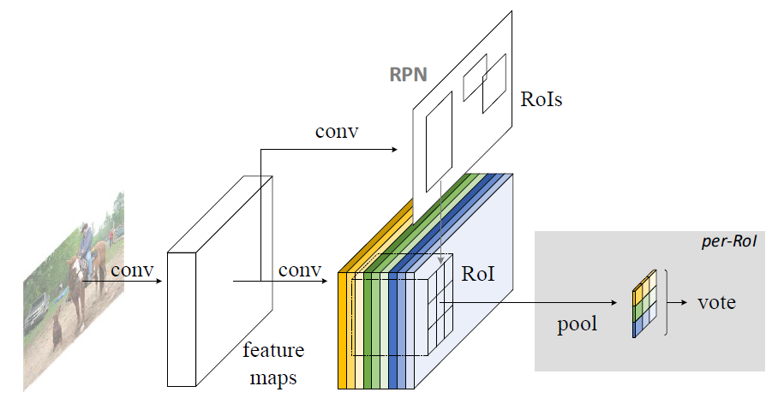
Innovative Approach
Introducing R-FCN: Region-based Fully Convolutional Networks.
R-FCN integrates region-based detection into a single network.
Streamlining object detection for improved efficiency.
Figure 2: Working of the R-FCN model

Slide 4
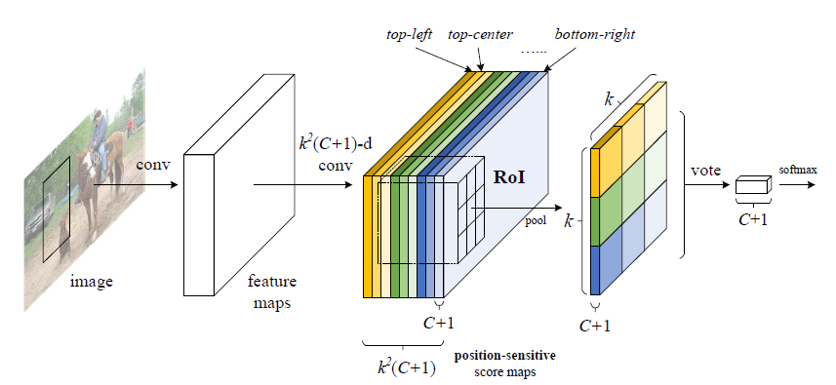
Key Techniques
PSSM and PS RoI Pooling are key techniques.
PSSM predicts object scores at different spatial positions.
PS RoI Pooling aggregates scores efficiently for classification.
Figure 3: Positive-Sensitive Score Maps & Positive-Sensitive ROI Pooling (k=3 in this figure)

Slide 5
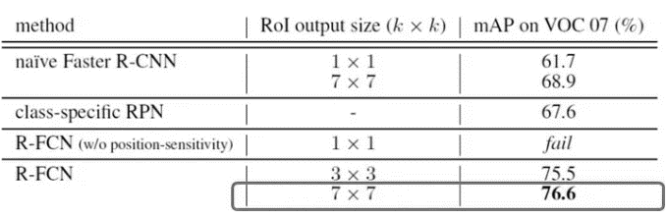
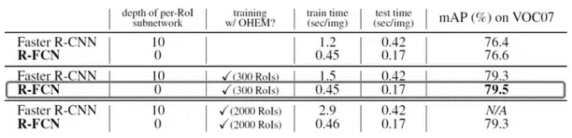
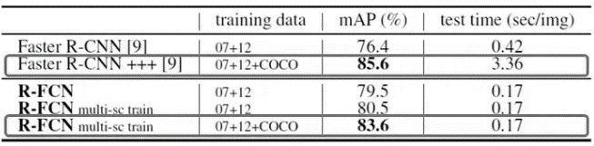
Advantages of R-FCN Over R-CNN
R-FCN is computationally efficient, eliminating the need for region proposal.
End-to-end training in R-FCN improves convergence and performance.
Streamlined object detection
Table 1: Comparison between R-FCN and R-CNN

Slide 6
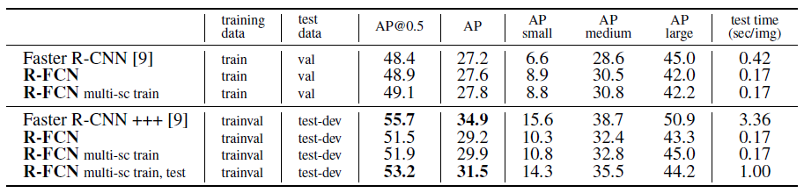
Important Results
R-FCN outperforms previous methods in accuracy while remaining efficient.
R-FCN demonstrates 20x faster than the Faster R-CNN.
Demonstrates its potential for advancing object detection.
Table 2: Comparisons on MS COCO dataset using ResNet-101

Slide 7
Discussion
Strengths of R-FCN include simplification and competitive accuracy.
Challenges involve computational cost, complexity, and limited real-time exploration.
Opportunities for further enhancements.

Slide 8
Conclusion and Call to Action
Promising advancement in object detection technology.
Simplifies the process, maintains high accuracy, and offers the potential for further improvements.

